Slide 1

Homework 3 Design and Manufacturing
Kimberly Velez
Kyle Swanton

Slide 2
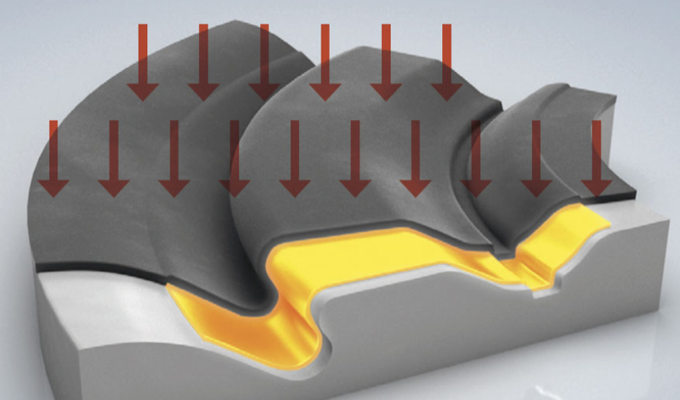
Background
Warm forming sheet metals induces flow stress into the part
Knowing this stress is very important for analyzing the parts
Current physical models don’t have enough precision in prediction of stress at various strain rates and temperatures
KS
Notes:
First, I’ll provide some background information about the project. The project pertains to warm forming of sheet metals. Warm forming sheet metals induces flow stress into the metal. Knowing this stress is very important for analyzing the parts in simulations. Currently, physical models don’t have precision required by simulations for prediction of stress at various strain rates and temperatures. The image to the right demonstrates a warm forming process, where a thin metal sheet is pressed into a mold so that it acquires its shape.

Slide 3
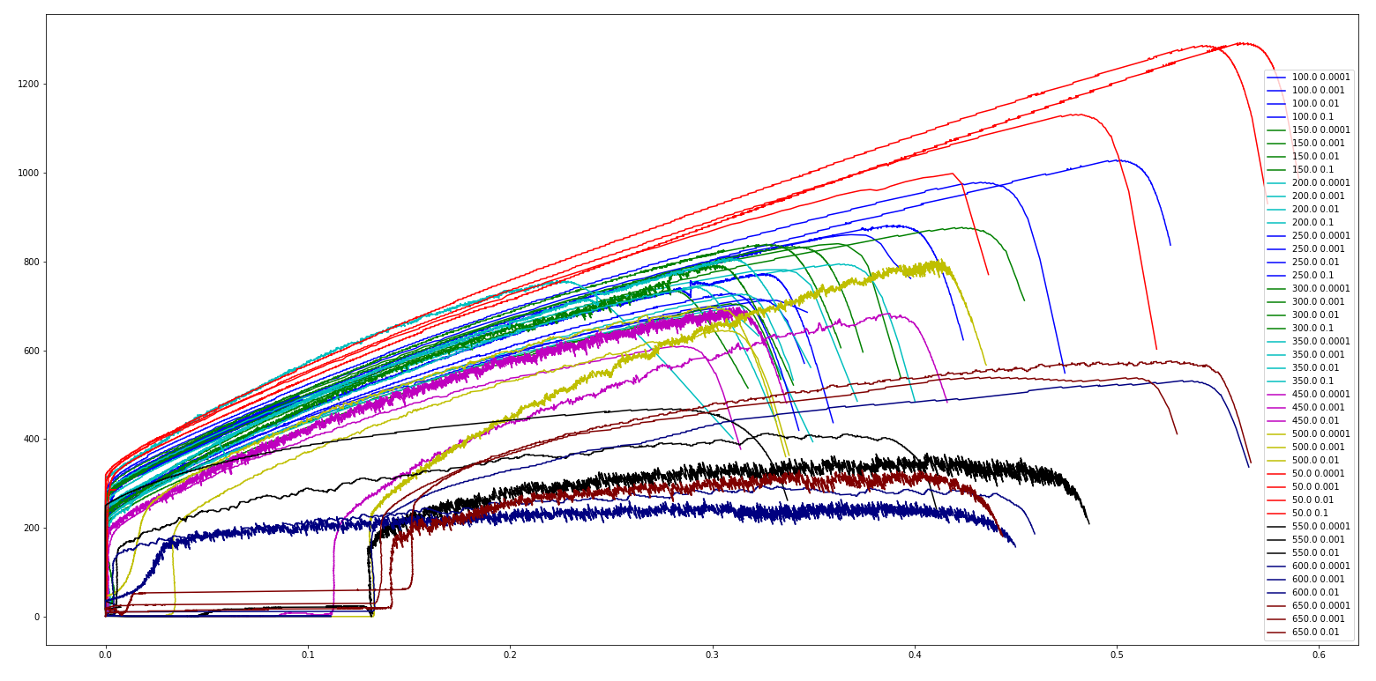
The Dataset
43 stress vs. strain curves were provided for:
Temperatures ranging from 50 – 650
Strain rates ranging from 0.0001 to 0.1
Utilize machine learning techniques to predict stress
Notes:
The data comes from tensile tests of austenitic stainless steel. This type of steel has a dynamic strain ageing phenomenon at higher temperatures, which means that the strain rate and temperature play a role in the resulting stress strain curves. The tests include 12 different temperatures and strain rates ranging from 0.001 to 0.1. Our goal is to try to predict stress based on strain, temperature and strain rate.

Slide 4
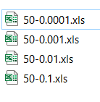
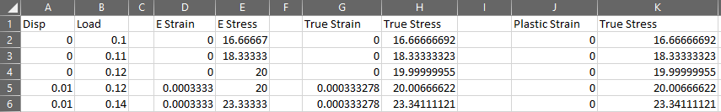
Data Loading
Add missing J:K columns in 2 files
Update incorrect formulas in J:K columns in 9 files
Remove extraneous text in J:K columns in 2 files
Change our file reading strategy multiple times due to:
Inconsistent column names in J:K
Missing column names in A for 2 files
SSK
Notes:
The data loading portion of this project was much more challenging and time-consuming than we originally anticipated. We tried several different data loading functions. Several times after writing the data loading script we found that the import fail after loading only a portion of the data files. Troubleshooting these issues required manually opening the data files in excel to view the file contents. We tried to modify our data loading script so that we would not have to physically alter the dataset provided to us, but this task was difficult based on the number of inconsistencies between data files. Several of the inconsistencies are listed here.
2 data files were missing the plastic strain and true stress data in columns J:K that the rest of the files had. We had to manually create these columns and save those files. 9 of the files had incorrect formulas for the calculation of plastic strain. We had to fix the formulas in these columns and save the files.
2 of the files had text after blank rows in the J:K columns. In one of these files the text was in the very last row in excel, which caused very slow data loading. We eventually found this error when NaNs showed up in our dataset after loading. We deleted these unneeded values from the files and saved them.
At one point we tried to load data by column name, but found that there were several inconstancies in the names of the columns. We modified our code to accept column names with any combination of lowercase, uppercase, and leading or trailing white space. Eventually we ran into a data file with ‘strain’ misspelled, and abandoned the import by column name strategy.
We swithed our file loading technique to read in any named columns, as to avoid the need to worry about variations in the column names. This failed part way through loading the files, and we found that 2 of the files had missing column names in cell A1
In total, we spent several hours writing, testing, troubleshooting, and re-writing our data files and data loading code for import, but were able to get the files loaded successfully in the end.

Slide 5
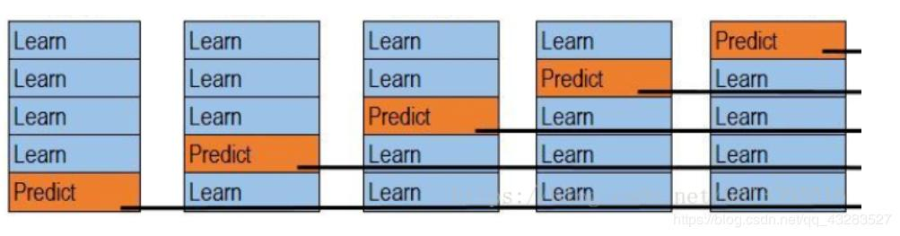
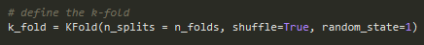
Data-Split (K-Fold)
K-Fold is a training strategy where the training data is divided into 5 subsets
In the first fold, four of the subsets are used to train the model and one subset is used to validate the mode
In the subsequent folds each subset is iterated through as the validation subset
When creating the subsets, we chose to shuffle the data within each subset
This Photo by Unknown Author is licensed under CC BY-SA
Notes:
We used a k-fold strategy during training. With this strategy we divided the training data into 5 subsets. In the first k-fold four of the subsets are used in training the model, and one is used to validate the model. In the subsequent 4 kfolds, the other subsets are iterated through as the validation subset.
When creating each k fold subset, we chose to shuffle the data.

Slide 6
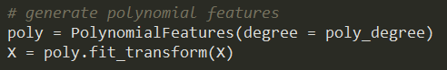
Naïve Neural Network: Set-up
Polynomial expansion on inputs
1 fully connected hidden layer
KS
Notes:
The features in the dataset provided to us were strain, strain-rate, and temperature. We searched through several avaible sample codes for neural networks using PyTorch, the machine learning library that we used in class. We found that one of the same codes recommended applying a polynominal expansion on the input features so that we would have feature columns for strain squared, strain-rate squared, and temperature squared. We carried this practice over into our code and found that it did help improve the fits of the models.
We set up a simple neural network with 1 hidden layer using PyTorch’s Sequential class. We first applied a linear transform of the data into 20 features, then reduced it back to 1 feature so that we could predict true stress

Slide 7
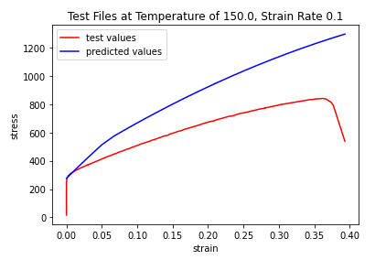
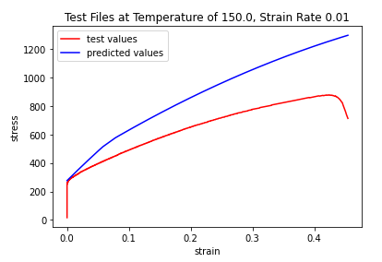
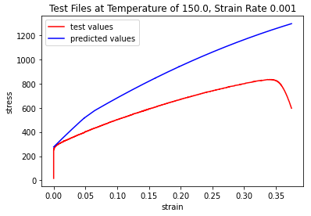
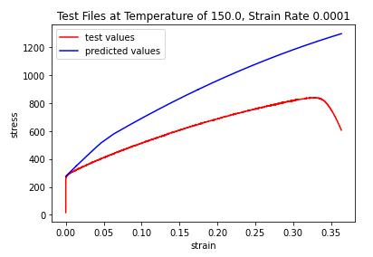
Naïve Neural Network: 150 C Results
The Naïve Neural Network seems to have learned a specific shape, seen in blue
In this example, the inputs are very similar and lead to similar predicted values
The ML algorithm predicts the starting values well, but quickly deviates in the higher strain regions
Notes:
For the test data we pulled out the 150 and 550 Celsius results. Here we see the model predictions of the naïve neural network on the 150 C data.
In red we have the actual curve and in blue we have the predicted curve. In this case, the predictions at lower strains match well, but at higher strains they start to deviate quickly.
It also has not seemed to learn the final fracture event, as seen in the red as the hook at the end of the curve. The predicted curves do not have this fractur event and instead continue on nearly linearly.
It is interesting to note that the results between the different strain rates do not seem to differ greatly. As the test results (in red) between the different strain rates do not differ greatly, it is probably the case that the dataset did not show a heavy dependence on strain rate. Without this dependence in the dataset, the naïve neural network was unable to discern a pattern to recreate.

Slide 8
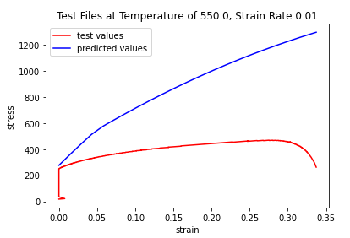
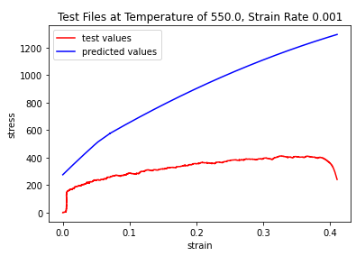
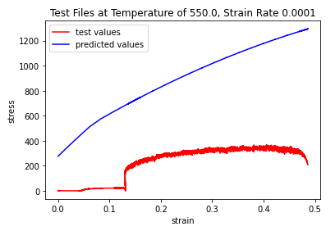
Naïve Neural Network: 550C Results
The same overall shape is seen again here in blue
The NNN does not do well to predict the initial 0 stress field in the final set of data
Notes:
Here are the 550 Celsius results. Again we have the test results in red and the predicted results in blue. I want to point out that the results at this temperature and strain rate do not differ greatly to the curves seen at the 150 Celsius temperature. This seem to point to the naïve neural network having learned a stress results primarily based on the strain results, with almost no impact from the strain rate or temperature.

Slide 9
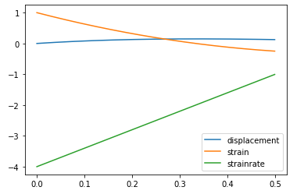
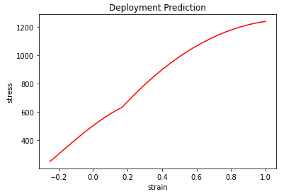
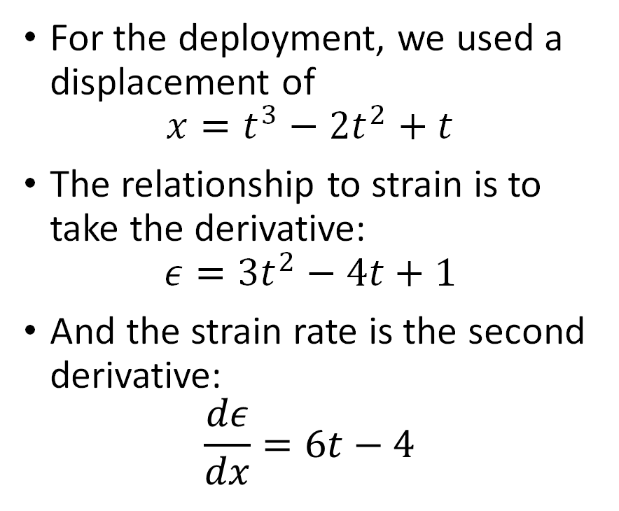
Naïve Neural Network: Deployment Results
For the deployment, we used a displacement of
$$x=t^{3}−2t^{2}+t$$
The relationship to strain is to take the derivative:
$$ε=3t^{2}−4t+1$$
And the strain rate is the second derivative:
$$\frac{dε}{dx}=6t−4$$
Notes:
For the deployment, we used a displacement of x = …, where t is time. This equation was assumed because it would get a non-constant strain rate and we were interested in how the model would react to the non constant strain rate.
The strain is related to the displacement as the first derivative of the displacement, shown here as e =
The strain rate is the second derivative of the displacement, shown here as de/dx.
The first plot on the right shows all the displacement, strain, and strain rate of the component over 0.5 seconds.

Slide 10
Naïve Neural Network: Deployment Results
Using a temperature of 100 C, we put the strain and strain rate of this deployment data into our model
The results are interesting, with a downward bend around 0.3 strain instead of an upward bend as seen in the other data
Notes:
For this model we also need a temperature. For the deployment we used 100 Celsius.
The results are interesting, with a downward bend around 0.3 strain instead of an upward bend as seen in the other datasets.
It should be noted that the strain rate is not only non-constant, it is actually negative. This would correspond to a strain that starts high and then decreases as the test progresses.
The resultant stress strain curve has the same value range as the other curves, with an inverted kink around 0.3.

Slide 11
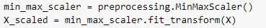
LSTM: Setup
The strain data was reorganized to include 5 consecutive strain measurements, then the temperature, and strain rate per line:
[strain 0, strain 1, strain 2, strain 3, strain 4, temperature, strain rate]
[strain 1, strain 2, strain 3, strain 4, strain 5, temperature, strain rate]
.
.
.
[strain n-4, strain n-3, strain n-2, strain n-1, strain n, temperature, strain rate]
Both the input (above) and the output (stress) were normalized using MinMaxScalar
Notes:
With the LSTM, we needed to give additional context to the strain data. We achieved this by serializing 5 consecutive strain points per row, which will allow the model to learn more about the environment around each strain datapoint, in addition to having the temperature and strain rate
We normalized both the inputs and the outputs using MinMaxScaler, this is important because the strains are significantly less than one and the stresses are in the hundreds range. Normalization allows better learning by the model.

Slide 12
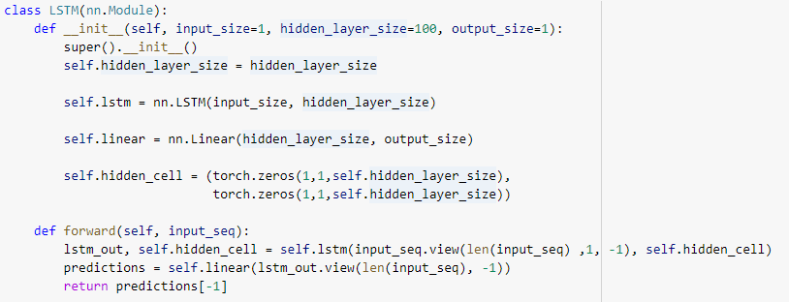
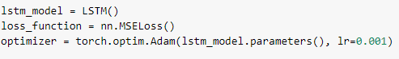
LSTM: Neural Network
We used a LSTM module from PyTorch, with a hidden layer size of 100
We chose MSE as our loss function and Adams as our optimizer
For the k-fold we decided not to shuffle the data, and this produced better results

Slide 13
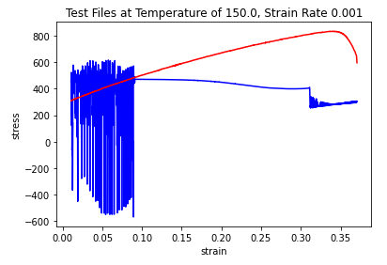
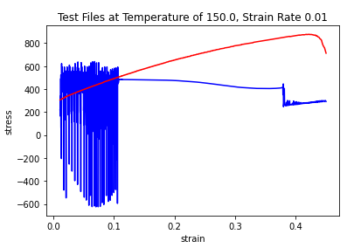
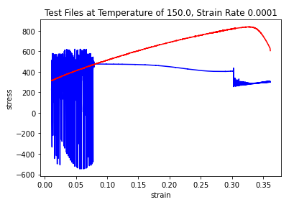
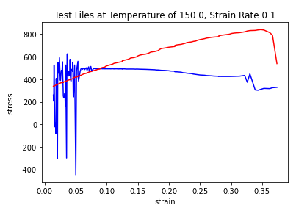
LSTM: 150 C Results
The LSTM seems to have had a difficult time learning the low strain values
The datasets conflict significantly in the lower region, which shows up here with obvious instability
The LSTM seems to have learned that the end of the test will show a sharp decrease
Overall trends are interesting here, though the exact predictions do not track well

Slide 14
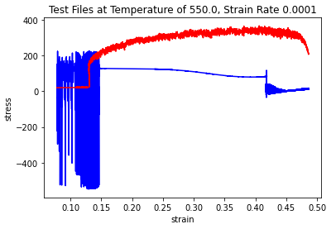
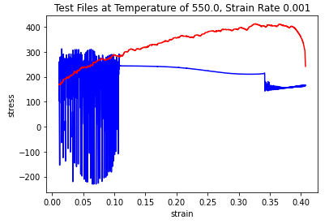
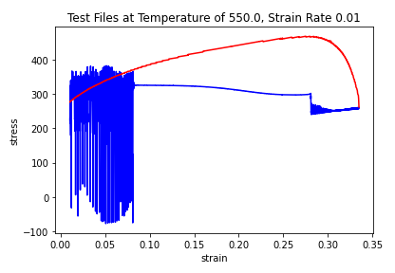
LSTM: 550C Results
As compared with the naïve neural network, the LSTM did a much better job predicting for the 0.0001 and 550C in the low strain regions

Slide 15
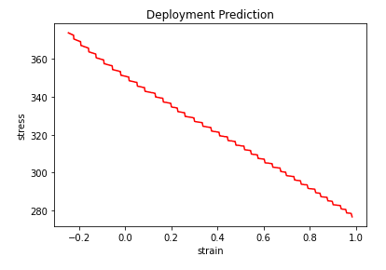
LSTM: Deployment Results
For the deployment, we used a displacement of
$$x=t^{3}−2t^{2}+t$$
The relationship to strain is to take the derivative:
$$ε=3t^{2}−4t+1$$
And the strain rate is the second derivative:
$$\frac{dε}{dx}=6t−4$$
Notes:
For the deployment, we used a displacement of x = …, where t is time. This equation was assumed because it would get a non-constant strain rate and we were interested in how the model would react to the non constant strain rate.
The strain is related to the displacement as the first derivative of the displacement, shown here as e =
The strain rate is the second derivative of the displacement, shown here as de/dx.
The first plot on the right shows all the displacement, strain, and strain rate of the component over 0.5 seconds.

Slide 16
LSTM: Deployment Results
Using a temperature of 100 C, we put the strain and strain rate of this deployment data into our model
The LSTM give a very different result for this input, as compared to the naïve neural network that gave essentially the same result as for the other tests

Slide 17
Future Work
Naive Neural Network
Vary the number of features in intermediate layer
Increase the number of layers
Reduce the number of data points
LSTM Neural Network
More investigation into the contribution of each parameter
Vary the size of the hidden layer
Notes:
We learned a lot from this project, and see opportunities for future work for this data-set. It would be valuable to do additional testing on the Naïve neural network to identify what the optimum number of features in a single intermediate layer is, as a balance of training time and model accuracy. It would also be interesting to perform a similar study on the number of fully connected intermediate layers. Finally, It could be investigated how senisitive the model is to smaller number for data files, and train the model only on half the data set.
If time allowed, we see value in additional work for the LSTM for completing parameters studies on the hidden layer size, the number of previous strain points to use, shuffling the kfold, just to name a few.

Slide 18
GitHub Code Submission
Plots differ slightly due to retraining with each run
https://github.com/kvelez-iastate/S2021_ME592.git

